Slide 1

StaRtistics introduction to statistics

Slide 2
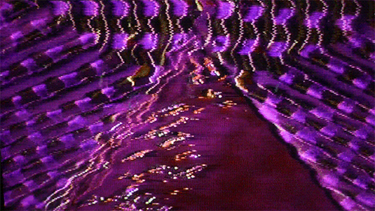
Class III

Slide 3

Advanced regression models

Slide 4

Linear regressions can be a kind of computational model… we can predict values of y from x!

Slide 5
Types of regression models
Linear Model:
Used when the outcome variables are continuous
Logistic Model:
Used when the outcome variables are binary
Hierarchical Model:
Used when your data has a defined structure (i.e., variables are nested)

Slide 6
Linear Regression Models
Coding of your ordinal predictors is important for the interpretation of your betas/ coefficients:
Linear coding: 1 2 3 assumes that there is a linear relationship between the orders (i.e., x=1 is half of x=2, etc.)

Slide 7
Linear Regression Models
Coding of your categorial predictors is very important for the interpretation of your betas:
Dummy coding
Effect Coding

Slide 8
Dummy coding
Let’s say we have two categorical variables:
Attention
(high vs low)
Difficulty
(easy vs hard)
Dummy code them as 0 and 1
Attention | Difficulty | Dummy Attention | Dummy Difficulty
High | easy | 1 | 0
Low | easy | 0 | 0
High | easy | 1 | 0
High | hard | 0 | 1
Low | hard | 1 | 1
High | hard | 0 | 1
Attention (X1) | Difficulty (X2) | Var Attention | Var Difficulty
High | easy | 1 | 0
Low | easy | 0 | 0
High | easy | 1 | 0
High | hard | 1 | 1
Low | hard | 0 | 1
High | hard | 1 | 1

Slide 9
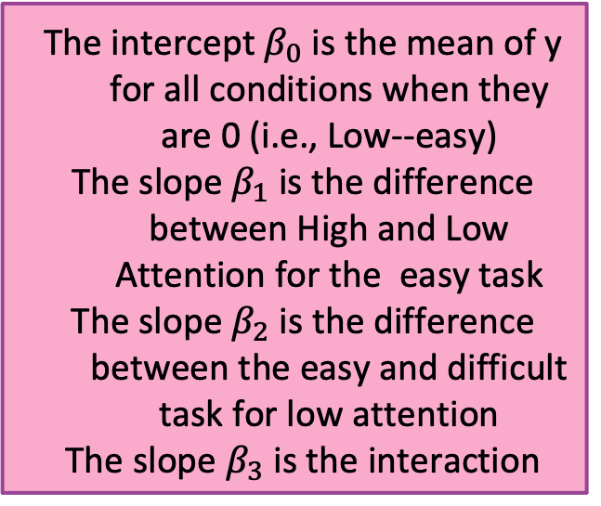
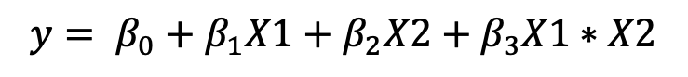
Dummy coding
Attention (X1) | Difficulty (X2) | Var Attention | Var Difficulty
High | easy | 1 | 0
Low | easy | 0 | 0
High | easy | 1 | 0
High | hard | 1 | 1
Low | hard | 0 | 1
High | hard | 1 | 1
The intercept $β_{0}$ is the mean of y for all conditions when they are 0 (i.e., Low--easy)
The slope $β_{1}$ is the difference between High and Low Attention for the easy task
The slope $β_{2}$ is the difference between the easy and difficult task for low attention
The slope $β_{3}$ is the interaction
$$y= β_{0}+β_{1}X1+β_{2}X2+β_{3}X1∗X2$$

Slide 10




Dummy coding
Our regression model: $y= β_{0}+β_{1}X1+β_{2}X2+β_{3}X1∗X2$
$$y= β_{0}+β_{1}0+β_{2}0+β_{3}0∗0$$
$$y= β_{0}$$
$$y= β_{0}+β_{1}1+β_{2}0+β_{3}1∗0$$
$y= β_{0}$ $+β_{1}$
$$y= β_{0}+β_{1}0+β_{2}1+β_{3}0∗1$$
$y= β_{0}$ $+β_{2}$
$$y= β_{0}+β_{1}1+β_{2}1+β_{3}1∗1$$
$y= β_{0}$ $+β_{1}+β_{2}+β_{3}$

Slide 11

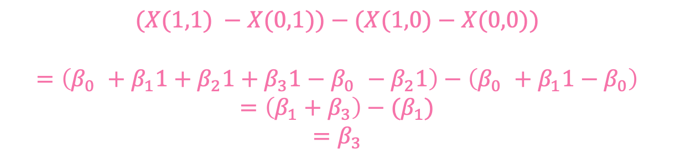

Dummy coding
Our regression model: $y= β_{0}+β_{1}X1+β_{2}X2+β_{3}X1∗X2$
$X\left(1,0\right)− X\left(0,0\right)= β_{0}+β_{1}1−$ $β_{0}$
$$X\left(1,0\right)− X\left(0,0\right) = β_{1}$$
$X\left(0,1\right)− X\left(0,0\right)= β_{0}+β_{2}1−$ $β_{0}$
$$X\left(0,1\right)− X\left(0,0\right) = β_{2}$$
$$(X(1,1) −X(0,1))−(X(1,0)−X(0,0))$$
$$=\left(β_{0} +β_{1}1+β_{2}1+β_{3}1−β_{0} −β_{2}1\right)−\left(β_{0} +β_{1}1−β_{0}\right)$$
$$=\left(β_{1}+β_{3}\right)−(β_{1})$$
$$=β_{3}$$

Slide 12
Effect coding
Attention | Difficulty | Dummy Attention | Dummy Difficulty
High | easy | 1 | 0
Low | easy | 0 | 0
High | easy | 1 | 0
High | hard | 0 | 1
Low | hard | 1 | 1
High | hard | 0 | 1
Attention (X1) | Difficulty (X2) | Var Attention | Var Difficulty
High | easy | 1 | -1
Low | easy | -1 | -1
High | easy | 1 | -1
High | hard | 1 | 1
Low | hard | -1 | 1
High | hard | 1 | 1
In effect coding all columns of variables sum to 0
To do this let’s try replacing the 0’s with -1

Slide 13
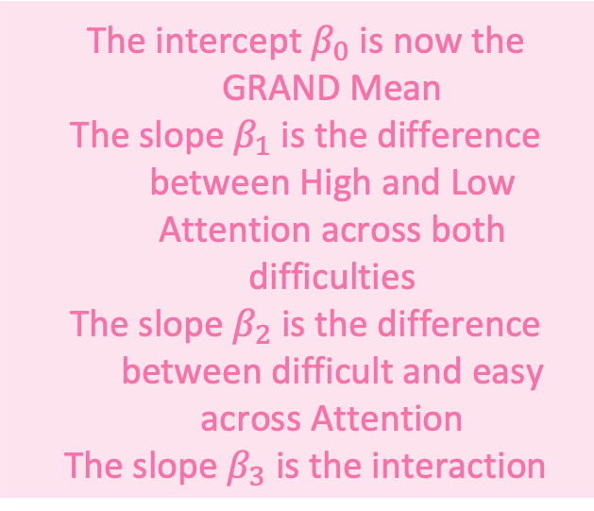
Effect coding
The intercept $β_{0}$ is now the GRAND Mean
The slope $β_{1}$ is the difference between High and Low Attention across both difficulties
The slope $β_{2}$ is the difference between difficult and easy across Attention
The slope $β_{3}$ is the interaction
Attention | Difficulty | Dummy Attention | Dummy Difficulty
High | easy | 1 | 0
Low | easy | 0 | 0
High | easy | 1 | 0
High | hard | 0 | 1
Low | hard | 1 | 1
High | hard | 0 | 1
Attention (X1) | Difficulty (X2) | Var Attention | Var Difficulty
High | easy | 1 | -1
Low | easy | -1 | -1
High | easy | 1 | -1
High | hard | 1 | 1
Low | hard | -1 | 1
High | hard | 1 | 1
$$y= β_{0}+β_{1}X1+β_{2}X2+β_{3}X1∗X2$$

Slide 14




Effect coding
Our regression model: $y= β_{0}+β_{1}X1+β_{2}X2+β_{3}X1∗X2$
$$y= β_{0}+β_{1}(−1)+β_{2}(−1)+β_{3}(−1)∗(−1)$$
$$y= β_{0}−β_{1}−β_{2}+β_{3}$$
$$y= β_{0}+β_{1}(1)+β_{2}(−1)+β_{3}(1)∗(−1)$$
$$y= β_{0}+β_{1}−β_{2}−β_{3}$$
$$y= β_{0}+β_{1}(−1)+β_{2}(1)+β_{3}(−1)∗(−1)$$
$$y= β_{0}−β_{1}+β_{2}−β_{3}$$
$$y= β_{0}+β_{1}(1)+β_{2}(1)+β_{3}(1)∗(1)$$
$$y= β_{0}+β_{1}+β_{2}+β_{3}$$

Slide 15
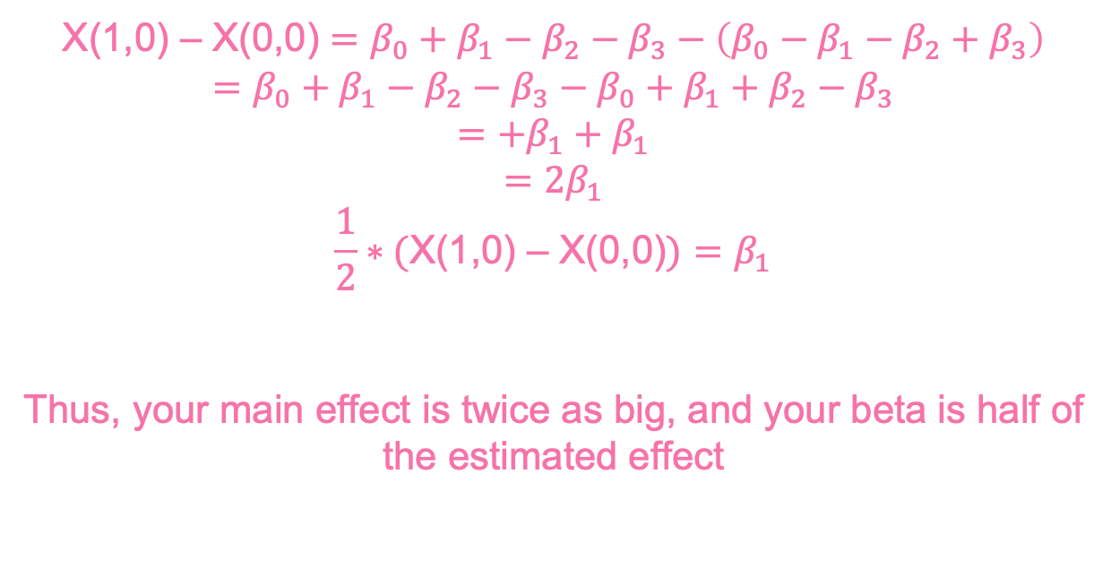
Effect coding
Our regression model: $y= β_{0}+β_{1}X1+β_{2}X2+β_{3}X1∗X2$
X(1,0) – X(0,0) $=β_{0}+β_{1}−β_{2}−β_{3}−\left(β_{0}−β_{1}−β_{2}+β_{3}\right)$
$$=β_{0}+β_{1}−β_{2}−β_{3}−β_{0}+β_{1}+β_{2}−β_{3}$$
$$=+β_{1}+β_{1}$$
$$=2β_{1}$$
$$\frac{1}{2}∗(\text{X}\text{(1,0) – }\text{X}\text{(0,0)})=β_{1}$$
Thus, your main effect is twice as big, and your beta is half of the estimated effect

Slide 16
Effect coding
Attention (X1) | Difficulty (X2) | Var Attention | Var Difficulty
High | easy | 0.5 | -0.5
Low | easy | -0.5 | -0.5
High | easy | 0.5 | -0.5
High | hard | 0.5 | 0.5
Low | hard | -0.5 | 0.5
High | hard | 0.5 | 0.5
What about replacing 0’s with -0.5 and 1’s with 0.5

Slide 17
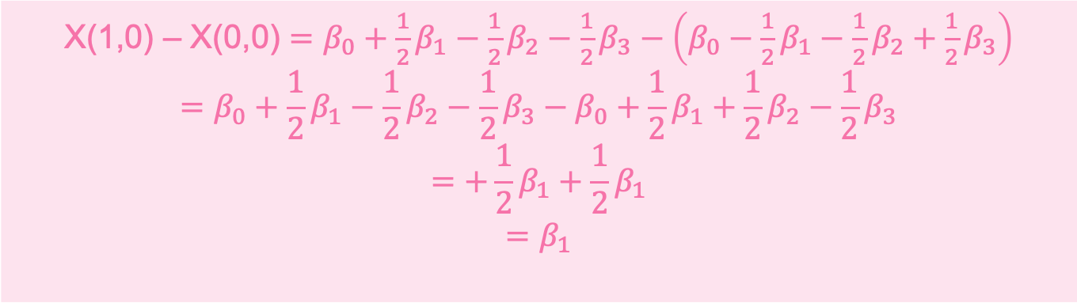
Effect coding
Our regression model: $y= β_{0}+β_{1}X1+β_{2}X2+β_{3}X1∗X2$
X(1,0) – X(0,0) $=β_{0}+{\frac{1}{2}β}_{1}−{\frac{1}{2}β}_{2}−\frac{1}{2}β_{3}−\left(β_{0}−{\frac{1}{2}β}_{1}−{\frac{1}{2}β}_{2}+\frac{1}{2}β_{3}\right)$
$$=β_{0}+{\frac{1}{2}β}_{1}−{\frac{1}{2}β}_{2}−{\frac{1}{2}β}_{3}−β_{0}+{\frac{1}{2}β}_{1}+\frac{1}{2}β_{2}−{\frac{1}{2}β}_{3}$$
$$=+\frac{1}{2}β_{1}+{\frac{1}{2}β}_{1}$$
$$=β_{1}$$

Slide 18
Linear Regression Models
Regressions can be used in different fashions: testing statistical relationships, predicting future data, removing effects from your data
After fitting regressions, you can compute and utilizes the residuals (i.e., the unexplained variance or y) for further analysis… we want the residuals of a regression to be normal

Slide 19
Linear Regression Models
Because of how linear regressions compute effects (holding all other effects at zero), you can add nuisance variables into your regression to compute your desired effect while controlling for the effect of another uninteresting variable
Alpha power $= β_{0}+β_{1}Age+β_{2}Attenion+β_{3} Sleep Quality$

Slide 20
Linear Regression Models
Because of how linear regressions compute effects (holding all other effects at zero), you can add nuisance variables into your regression to compute your desired effect while controlling for the effect of another uninteresting variable
Alpha power $= β_{0}+β_{1}Age+β_{2}Attenion+β_{3} Sleep Quality$

Slide 21
Linear Regression Models
Because of how linear regressions compute effects (holding all other effects at zero), you can add nuisance variables into your regression to compute your desired effect while controlling for the effect of another uninteresting variable
Alpha power $= β_{0}+β_{1}Age+β_{2}Attenion+β_{3} Sleep Quality$
controlling for age effects / confounds

Slide 22
Multicollinearity
A problem when two or more of your predictors / regressors/ measures are related to one another (i.e., correlated)
For example, participant height and weight
One assumption of regressions are that the measures are independent, and if this violated the beta coefficients estimated become unstable and sensitive to small changes

Slide 23
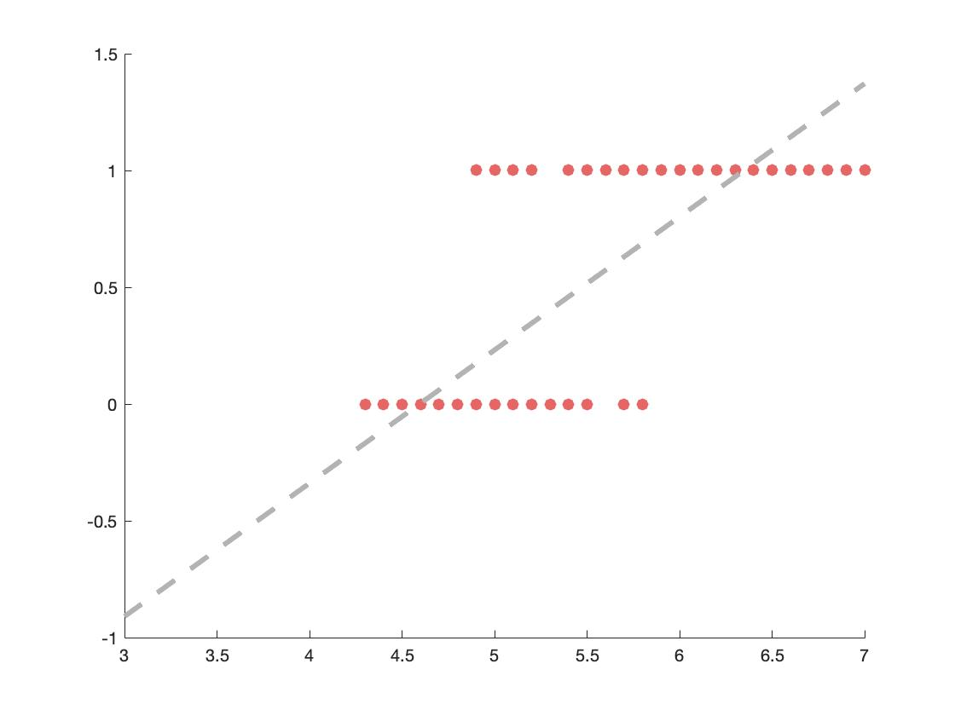
Logistic Regression
Linear regression work very well on continuous outcomes, but what happens when your outcome is categorical or binary? Fitting a line just doesn’t cut it

Slide 24
Logistic Regression
But if we fit a different function to the data, it might fit it much better…
Here comes in Logistic Functions

Slide 25
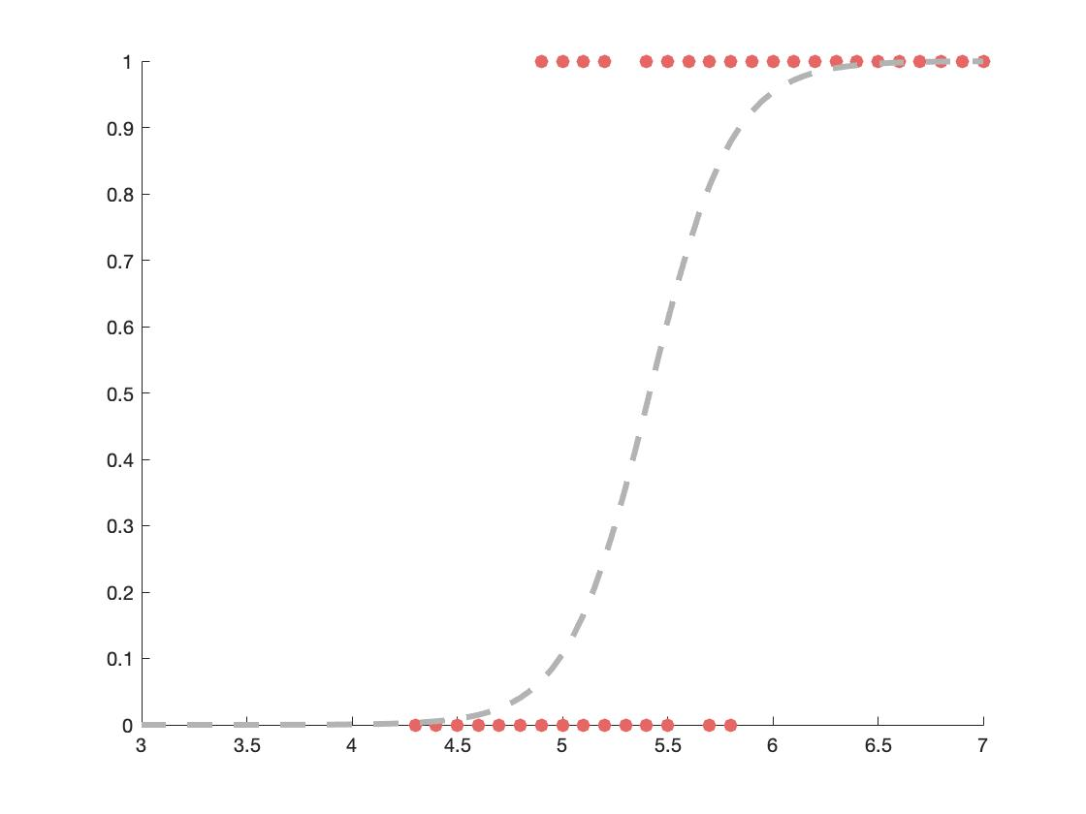
Logistic Regression
But if we fit a different function to the data, it might fit it much better…
Here comes in Logistic Functions

Slide 26
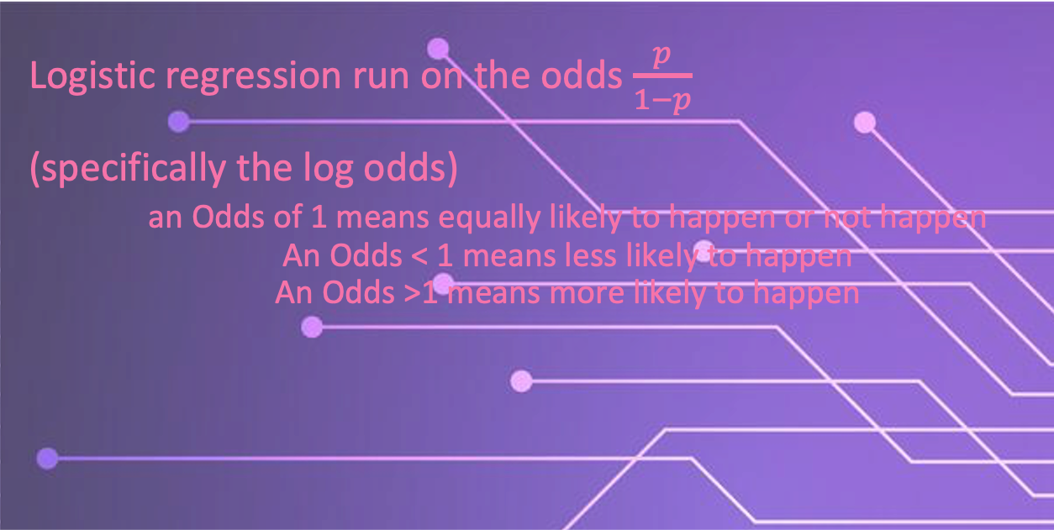
Logistic Regression
Logistic regression run on the odds $\frac{p}{1−p}$
(specifically the log odds)
an Odds of 1 means equally likely to happen or not happen
An Odds < 1 means less likely to happen
An Odds >1 means more likely to happen

Slide 27
Odds
Probability
0 0.5 1
p/(1-p)
Odds
0 1 Inf
ln(x)
Log Odds
-Inf 0 Inf

Slide 28
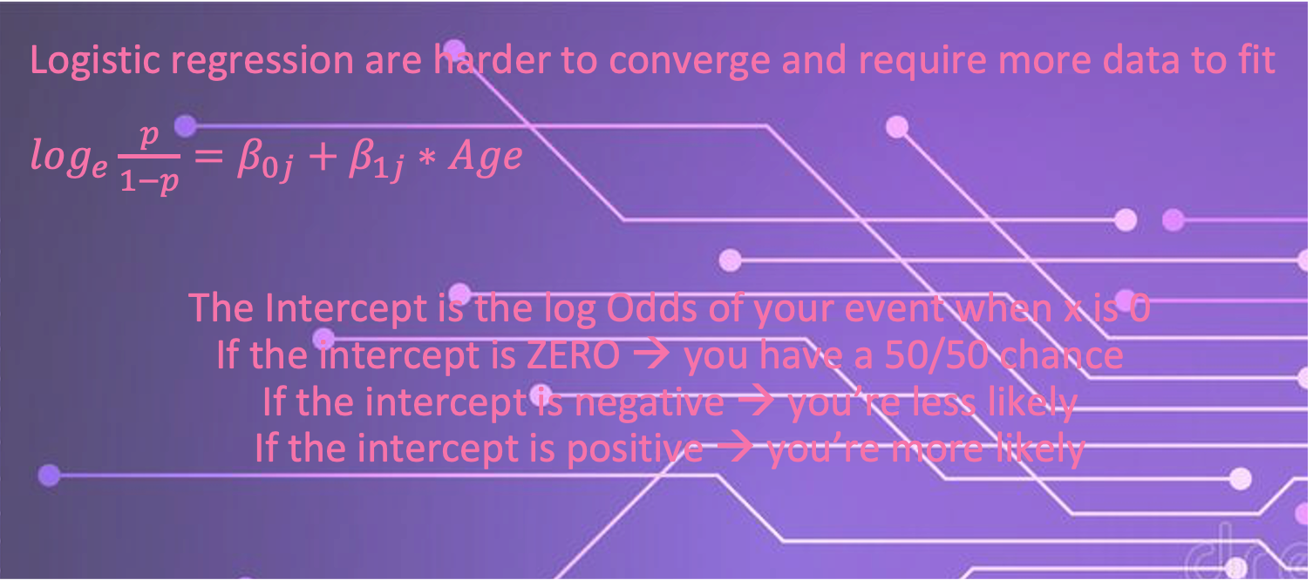
Logistic Regression
Logistic regression are harder to converge and require more data to fit
$\log_{e}\frac{p}{1−p}=β_{0j}+β_{1j}∗Age$
The Intercept is the log Odds of your event when x is 0
If the intercept is ZERO → you have a 50/50 chance
If the intercept is negative → you’re less likely
If the intercept is positive → you’re more likely

Slide 29
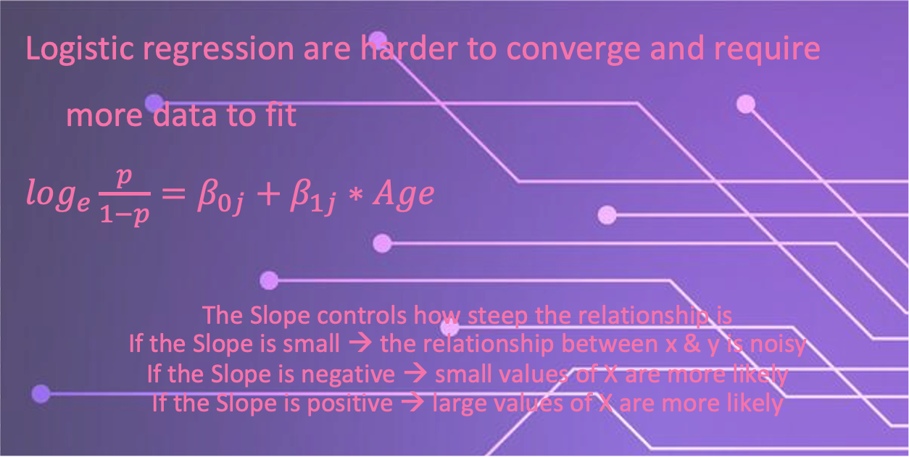
Logistic Regression
Logistic regression are harder to converge and require more data to fit
$\log_{e}\frac{p}{1−p}=β_{0j}+β_{1j}∗Age$
The Slope controls how steep the relationship is
If the Slope is small → the relationship between x & y is noisy
If the Slope is negative → small values of X are more likely
If the Slope is positive → large values of X are more likely

Slide 30
Hierarchical models

Slide 31


Nested data
What is the best song to dance to?

Slide 32






Nested data
What is the best song to dance to?

Slide 33
Nested data
What is the best song to dance to?
Le Club
Muzique
Le Rouge
GAY
Club MED
Studio 54

Slide 34
Nested data
What is the best song to dance to?
Canada
UK
USA
Le Club
Muzique
Le Rouge
GAY
Club MED
Studio 54

Slide 35

Nested data
Observations within the same country, for example, are more similar to themselves than to a different country
When data is nested, it is important that your model takes into account the correlational structure of your data

Slide 36
Nested data
Regressions assume that all your predictors (i.e., measures) are independent. But this may not always be the case, specifically for repeated measure designs where participants see multiple experimental conditions

Slide 37
Nested data
The independence of each observation is often violated in real life—data is nested in a big wonderful world
People are more similar to themselves, their family, their friends, people from their city, country etc

Slide 38
Nested data
Regression models need to consider the correlated structure of your observations to better deal with noise
Adding this info to your regression will allow you to better predict out of sample

Slide 39
Nested data
Hierarchical regressions allow you to take into account the structure of your data to help better estimate your effects and deal with noise that can be accounted for by your nested data

Slide 40
Nested data
This is achieved by allowing intercepts or slopes to vary as a function of the levels/ nests within your data

Slide 41
Nested data
For example, allowing every person in your sample to get a different intercept accounts for the fact that people have differences in mean response times

Slide 42
Hierarchical regressions
Fitting a line to our data sometimes does not capture the complicated effect we may have

Slide 43
Hierarchical regressions
Random Intercept
Sometime our effect is constant across individuals, but the baseline varies

Slide 44
Hierarchical regressions
Random Slope
Sometime our effect changes across groups too

Slide 45
Hierarchical regressions
http://mfviz.com/hierarchical-models/ interactive example

Slide 46
Fixed vs Random effects
Note that hierarchical models have both fixed and random effects
Fixed effects—assume you have every desired level of variable (e.g., experimental condition)
Random effects—assume you do not have every possible level you wish to test (e.g., participant)

Slide 47
Fixed vs Random effects
Fixed effects—sometimes are also referred to as variables you MANIPULATE
Random effects—sometimes referred to as variables that are sources of variation in your data that you do not care about

Slide 48
Model fitting

Slide 49
What is a model?

Slide 50


Slide 51
What is a model? A way to describee phenomena in abstract terms It helps us to understand, define, quantify or predict abstract-- removed from referent

Slide 52
What is a model? “the aim of which is to make a particular part or feature of the world easier to understand, define, quantify, visualize, or simulate “ --Wikipedia

Slide 53
Why use computational models
When studying the brain, we can try to understand how it works at different levels :
Knowing the gist of what a machine is doing/ purpose
Knowing the operations and procedures of the machine
Knowing how the machine implements said procedures

Slide 54
Why use computational models
In the case of a calculator for example:
We know that it adds numbers together
It does so through binary codes, circuits, and wires
It does this by passing electrical current and opening/closing transistors

Slide 55
How to fit a model?

Slide 56
Model fitting algorithms
All model fitting algorithms work by trying to find the global minima / maxima of your parameter space
If you think of all possible values of your model parameters plotted against error, fitting a model essentially tries to find the minima in this space

Slide 57
Model Error
Making predictions comes with some form of error, models are never perfect just like humans aren’t (f.t. Hannah Montana)
But there are many methods to compute how wrong your predictions are from your data

Slide 58
Model Error
It is important to note, however, that when you want to assess how good your model is predicting something you need to use data that your model has not seen (i.e., not been trained on)
This is done to avoid OVERFITTING (see slide 76)

Slide 59
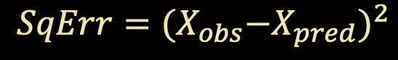

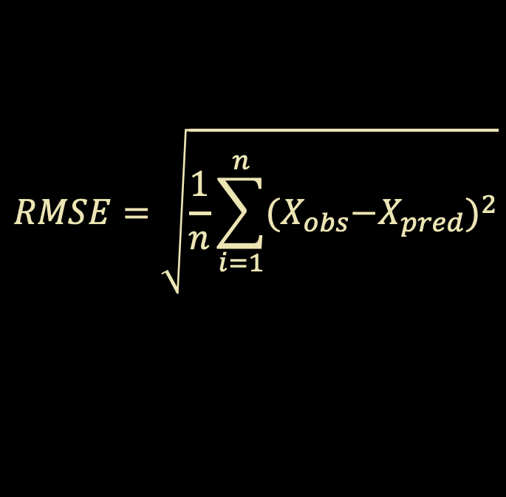
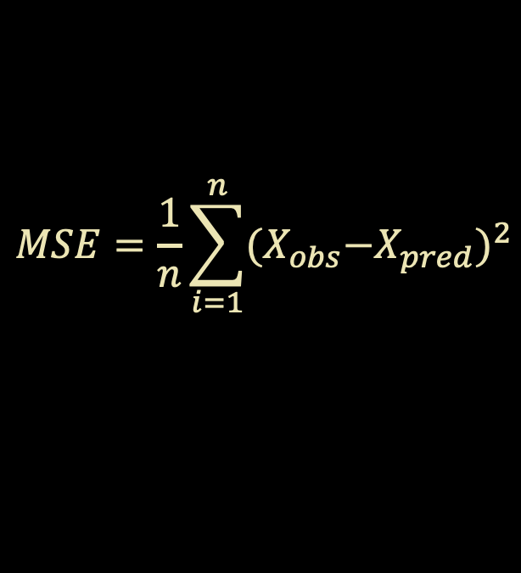
Flavours of Error
$$MSE=\frac{1}{n}\sum_{i=1}^{n}{{{(X}_{obs}−X_{pred})}^{2}}$$
$$Error=X_{obs}−X_{pred}$$
$$RMSE=\sqrt{\frac{1}{n}\sum_{i=1}^{n}{{{(X}_{obs}−X_{pred})}^{2}}}$$
$$SqErr={{(X}_{obs}−X_{pred})}^{2}$$

Slide 60
Picking the best model
The best fitting model is the one that predicts the data the best → this ultimately entails minimizing error (regardless of which kind of error you are measuring)
It is important to note that you want a model that minimizes error within your sample and across all other possible samples (i.e., generalizes)
But there are other considerations beyond minimizing error

Slide 61
Picking the best model
Instead of picking the best model by minimizing error, you can alternatively pick the best model by trying to maximize the likelihood
Said another way, picking a model that maximally produces data like yours

Slide 62
Likelihood functions

Slide 63
Likelihood is NOT probability
In stats probability represents possibilities that are exhaustive and mutually exclusive (e.g. a coin toss), they always add up to 1
Likelihoods do not need to be exhaustive or exclusive

Slide 64
So what is Likelihood
Looking at a probability density function we can understand the differences between probability and likelihood
Probability is the area under the curve up to a value xi
Likelihood is the value of the function at xi

Slide 65
So what is Likelihood

Slide 66
Example…
Let us assume we are a data scientists at Vogue and want to find out which musician is the most likely to have sung the latest hit song

Slide 67
Example…
J Lo
Mariah Carey

Slide 68
Example…
J Lo
Mariah Carey

Slide 69
Example…
J Lo
Mariah Carey

Slide 70
Example…

Slide 71
Likelihood
Therefore, we can see how maximizing the likelihood can generate a model that best explains the distribution of our data based on an unknown parameter (random variable)

Slide 72
Likelihood
The goodness-of-fit of models will be described in Log likelihoods. These values by themselves are meaningless. They can only tell you how well a model fits RELATIVE to another model fit on the SAME data.

Slide 73
Model selection
Each model has a different number of ‘free’ variables / values that can vary
The more your model is free to vary, the better it can fit data
Visually, this is the equivalent of adding more bends to your data
While we love flexibility, models that are too flexible are hard to interpret and tend not to generalize well

Slide 74
Model selection

Slide 75
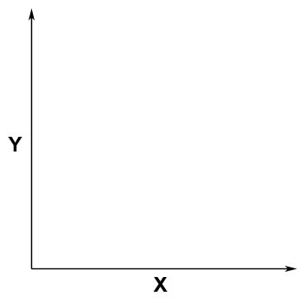
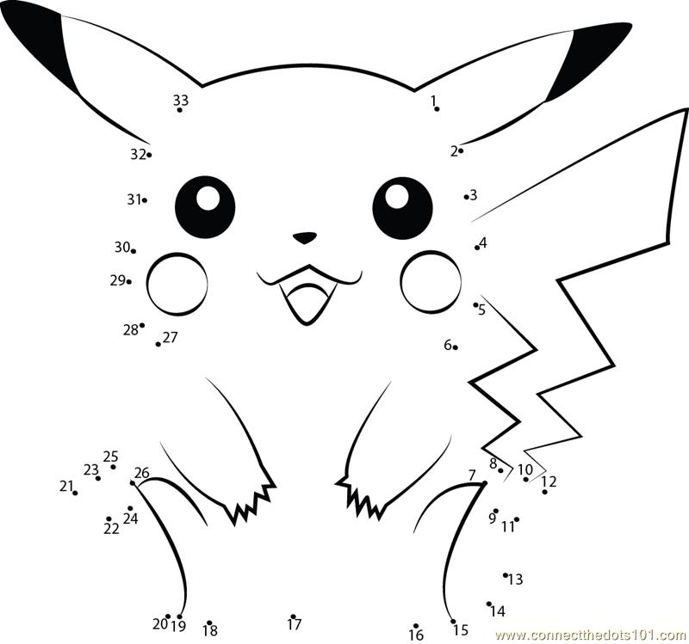
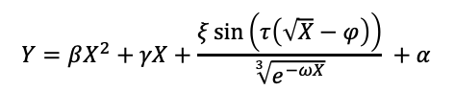
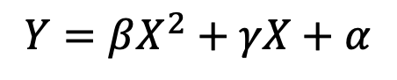
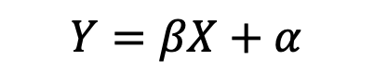
Overfitting
$$Y=βX+α$$
$$Y=βX^{2}+γX+α$$
$$Y=βX^{2}+γX+\frac{ξ\sin\left(τ\left(\sqrt{X}−φ\right)\right)}{\sqrt[3]{e^{−ωX}}} +α$$

Slide 76

Occam’s Razor
“Plurality should not be posited without necessity.”
Heuristic for the development of scientific models
Parsimonious
Falsifiable
Related to Overfitting

Slide 77
Model selection
We can try and quantify a measure that balances both the fit of the model as well as parsimony (i.e., the number of parameters)
Akaike information criterion (AIC).
−2logL(θ) + 2k
Bayesian information criterion (BIC)
−2logL(θ) + k*log(T)
Where k is the number of parameters fit to T observations

